Slide 1
Chapter Nine
Looking Out, Looking In
Communication and Relational Dynamics

Slide 2
Why We Form Relationships
Factors that influence our choice of relational partners:
Appearance
Similarity
Complementarity
Reciprocal attraction

Slide 3
Why We Form Relationships
Factors that influence our choice of relational partners (continued):
Competence
Disclosure
Proximity
Rewards

Slide 4
Models of Relational Dynamics
The developmental perspective
Initiating
Experimenting
Intensifying
Integrating
Bonding

Slide 5
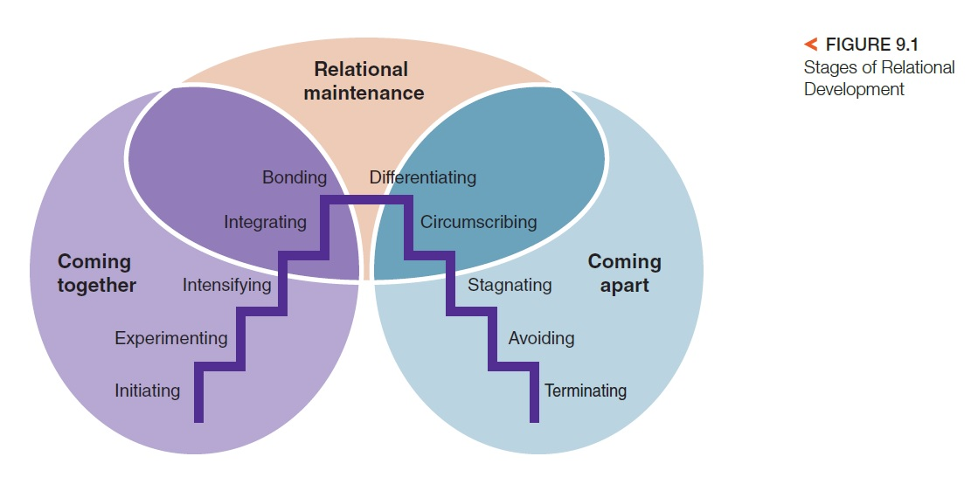
Models of Relational Dynamics
The developmental perspective (continued)
Differentiating
Circumscribing
Stagnating
Avoiding
Terminating
Grave dressing

Slide 6
Models of Relational Dynamics
The developmental perspective (continued)
Limitations of the developmental perspective
Too heavy a focus on sequential movement from one stage to the next
Ignores the idea that multiple stages may exist simultaneously

Slide 7
Models of Relational Dynamics
The dialectal perspective
Dialectal tensions
Connection-autonomy dialectic
Openness-privacy dialectic
Predictability-novelty dialectic

Slide 8
Models of Relational Dynamics
The dialectal perspective (continued)
Managing dialectal tensions
Denial
Disorientation
Alternation
Segmentation
Balance
Integration
Recalibration
Reaffirmation

Slide 9
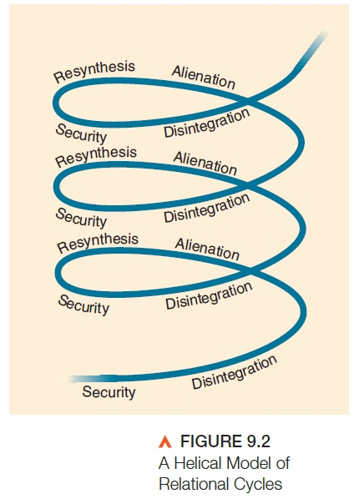
Characteristic of Relationships
Relationships are always changing
Relationships are affected by culture

Slide 10
Communicating About Relationships
Content and relational messages
Types of relational messages
Affinity
Immediacy
Respect
Control
Metacommunication

Slide 11
Maintaining Interpersonal Relationships
Relational maintenance
Strategies to keep relationships satisfying:
Positivity
Openness
Assurances
Social networks
Sharing tasks

Slide 12
Maintaining Interpersonal Relationships
Social support
Support resources:
Emotional support
Informational support
Instrumental support

Slide 13
Maintaining Interpersonal Relationships
Relational transgressions
Lack of commitment
Distance
Disrespect
Problematic emotions
Aggression

Slide 14
Maintaining Interpersonal Relationships
Relational transgressions (continued)
Minor versus significant
Social versus relational
Deliberate versus unintentional
One-time versus incremental

Slide 15
Maintaining Interpersonal Relationships
Strategies for relational repair
Expressing regret
Accepting responsibility
Making restitution
Genuinely repenting
Requesting forgiveness

Slide 16
Maintaining Interpersonal Relationships
Responding to transgressions
Acceptance
Rejection
Discussion

