Slide 1
Chapter Eleven
Looking Out, Looking In
Improving
Communication Climates

Slide 2
Communication Climate and Confirming Messages
Communication climate: the emotional tone of a relationship
Levels of message confirmation
Confirming communication
Disconfirming communication

Slide 3
Communication Climate and Confirming Messages
Levels of message confirmation (continued)
Disconfirming messages
Impervious responses
Interrupting
Irrelevant responses
Tangential responses
Impersonal responses
Ambiguous responses
Incongruous responses

Slide 4
Communication Climate and Confirming Messages
Levels of message confirmation (continued)
Disagreeing messages
Aggressiveness
Complaining
Argumentativeness

Slide 5
Communication Climate and Confirming Messages
Levels of message confirmation (continued)
Confirming messages
Recognition
Acknowledgement
Endorsement

Slide 6
Communication Climate and Confirming Messages
How communication climates develop
Self-perpetuating spiral
Escalatory conflict spiral
De-escalatory conflict spiral

Slide 7
Defensiveness: Causes and Remedies
Face-threatening acts
Preventing defensiveness in others
Evaluation versus description
Control versus problem orientation
Strategy versus spontaneity
Neutrality versus empathy
Superiority versus equality
Certainty versus provisionalism

Slide 8
Saving Face
The assertive message format
Behavior
Interpretation
Feeling
Consequence
Intention

Slide 9
Saving Face
Using the assertive message format
Elements may be delivered in mixed order
Word the message to suit your personal style
Combine two elements in a single phrase if appropriate
Take your time delivering the message

Slide 10
Saving Face
Responding nondefensively to criticism
Seek more information
Ask for specifics
Guess about specifics
Paraphrase the speaker’s ideas
Ask what the critic wants
Ask about the consequences of your behavior
Ask what else is wrong

Slide 11
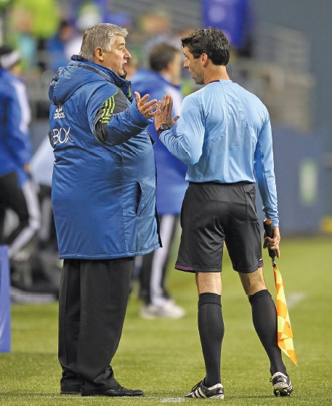
Saving Face
Responding nondefensively to criticism (continued)
Agree with the critic
Agree with the facts
Agree with the critic’s perception

