Slide 1
Chapter Two
Looking Out, Looking In
Interpersonal Communication and Social Media

Slide 2
Mediated Versus Face-to-Face Communication
Similarities between mediated and face-to-face communication
Same goals
Similar process
Similar principles

Slide 3
Mediated Versus Face-to-Face Communication
Differences between mediated and face-to-face communication
Leaner messages
Variable synchronicity
Permanent (sometimes public) record

Slide 4
Mediated Versus Face-to-Face Communication

Slide 5
Mediated Versus Face-to-Face Communication
Consequences of mediated communication
Disinhibition
Hyperpersonal communication

Slide 6
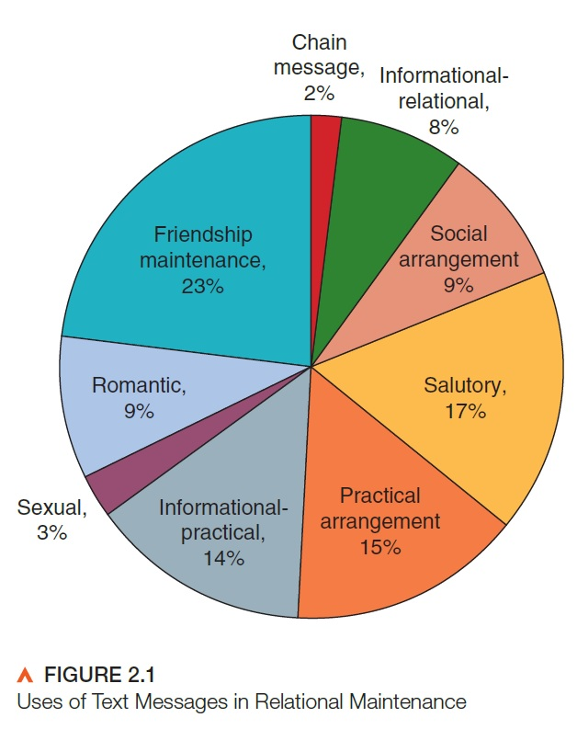
Benefits and Drawbacks of Mediated Communication
Benefits of mediated communication
More relational opportunities
Sustaining and enriching relationships
Social support

Slide 7
Benefits and Drawbacks of Mediated Communication
Drawbacks of mediated communication
Superficial relationships
Social isolation
Relational deterioration
Deception
Stalking and harassment
Cyberbullying

Slide 8
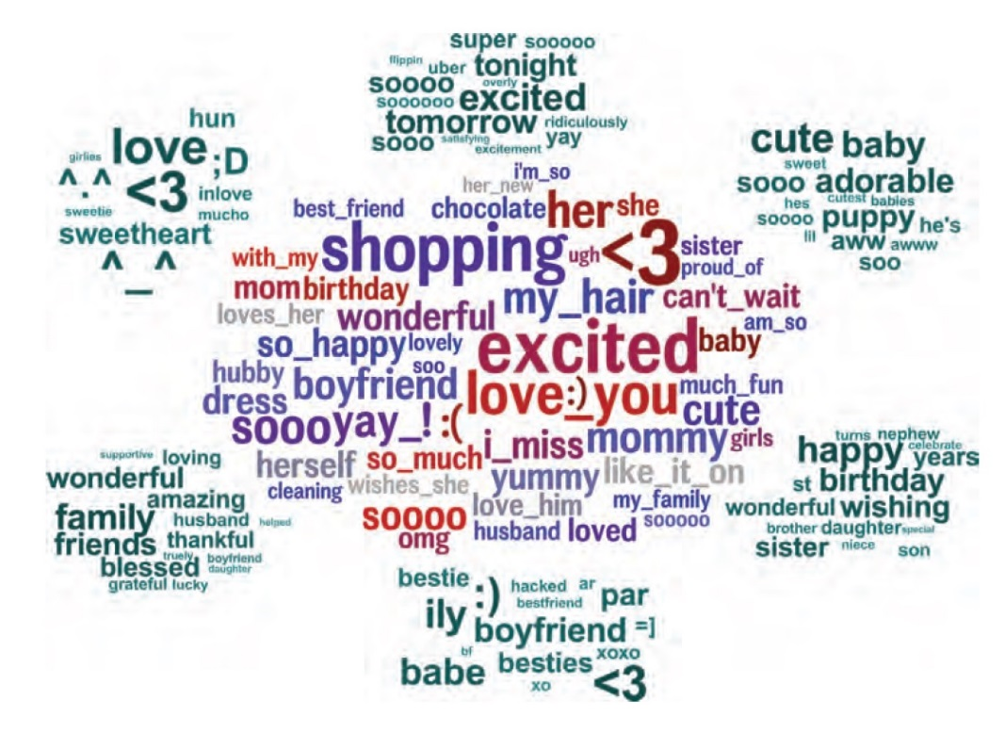
Influences on Mediated Communication
Gender
Women
Personal pronouns
Hedge phrases
Emotion words
Men
Large words
Nouns
Swear words
Object references

Slide 9
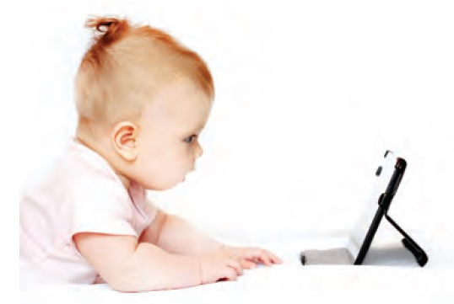
Influences on Mediated Communication
Age
Digital natives versus digital immigrants
Channel preferences
Topics of discussion

Slide 10
Competence in Social Media
Fostering positive relationships
Respect others’ need for undivided attention
Keep your tone civil
Don’t intrude on bystanders

Slide 11
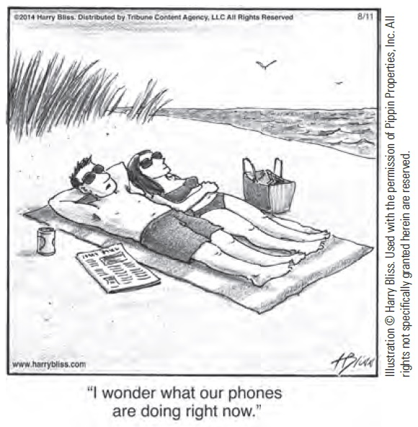
Competence in Social Media
Protecting yourself
Think before you post
Verify what you see online
Balance mediated and face time

