Slide 1
Chapter Ten
Looking Out, Looking In
Interpersonal Communication in Close Relationships

Slide 2
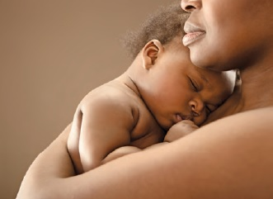
Intimacy in Close Relationships
Dimensions of intimacy
Physical
Intellectual
Emotional
Shared activities

Slide 3
Intimacy in Close Relationships
Masculine and feminine intimacy styles
Feminine gender role: intimacy through self-disclosure
Masculine gender role: intimacy through shared activities

Slide 4
Intimacy in Close Relationships
Cultural influences on intimacy
Intimacy in mediated communication
The limits of intimacy

Slide 5
Communication in Families
Characteristics of family communication
Family communication is:
Formative
Attachment theory
Role-driven
Involuntary

Slide 6
Communication in Families
Families as systems
Family systems are:
Interdependent
Manifested through communication
Nested
More than the sum of their parts

Slide 7
Communication in Families
Communication patterns within families
Conversation orientation
Conformity orientation
Family communication patterns
Consensual
Pluralistic
Protective
Laissez-faire
Social media and family communication

Slide 8
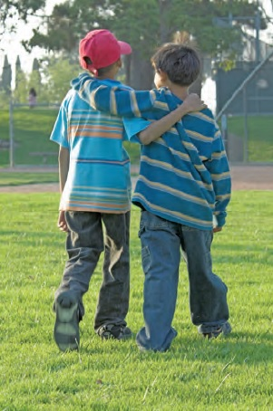
Communication in Friendships
Types of friendships
Youthful versus mature
Long term versus short term
Relationship oriented versus task oriented

Slide 9
Communication in Friendships
Types of friendships (continued)
High disclosure versus low disclosure
High obligation versus low obligation
Frequent contact versus occasional contact

Slide 10
Communication in Friendships
Sex, gender, and friendship
Same-sex friendships
Cross-sex friendships
Friends with benefits
Gender considerations
Gender roles
Sexual orientation
Social media and friendship

Slide 11
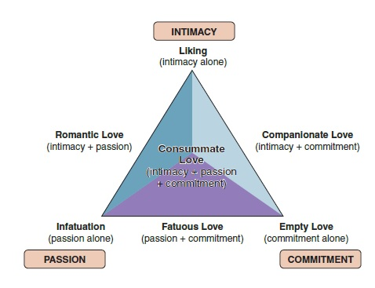
Communication in Romantic Relationships
Characteristics of romantic relationships
Love
Triangular theory of love (Robert Sternberg)
Intimacy
Passion
Commitment

Slide 12
Communication in Romantic Relationships
Characteristics of romantic relationships (continued)
Commitment
Relational commitment
Affection

Slide 13
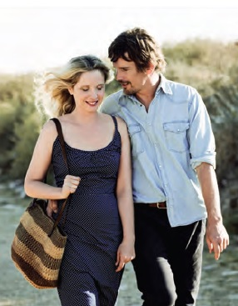
Communication in Romantic Relationships
Romantic turning points
Relational turning points
Couple’s conflict styles
Volatile
Avoidant
Validating

Slide 14
Communication in Romantic Relationships
Languages of love (Gary Chapman)
Words of affirmation
Quality time
Gifts
Acts of service
Physical touch
Social media and romantic relationships

