Slide 1
Chapter Twelve
Looking Out, Looking In
Managing
Interpersonal Conflicts

Slide 2
The Nature of Conflict
Conflict defined:
Expressed struggle
Perceived incompatible goals
Perceived scarce resources
Interdependence
Interference from the other party

Slide 3
The Nature of Conflict
Conflict is natural
Conflict can be beneficial

Slide 4
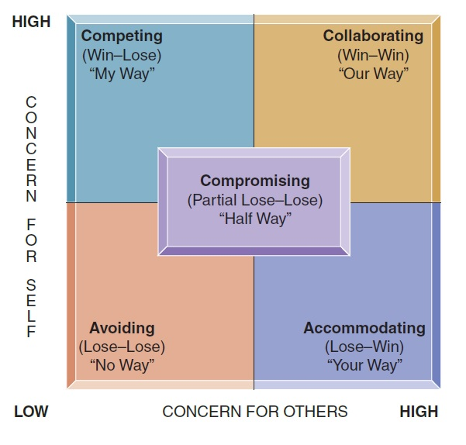
Conflict Styles
Conflict styles
Avoiding (lose-lose)
Accommodating (lose-win)
Competing (win-lose)
Direct aggression
Passive aggression
Compromising (partial lose-lose)
Collaborating (win-win)

Slide 5
Conflict Styles
Which style to use?
Consider these factors:
The relationship
The situation
The other person
Your goals

Slide 6
Conflict in Relational Systems
Relational conflict style: a pattern of managing disagreements
Complementary conflict style
Symmetrical conflict style
Parallel conflict style

Slide 7
Conflict in Relational Systems
Destructive conflict patterns
Criticism
Defensiveness
Contempt
Stonewalling
Conflict rituals

Slide 8
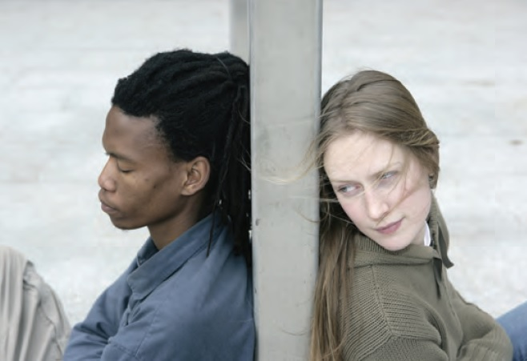
Variables in Conflict Styles
Variables in conflict styles
Gender
Culture

Slide 9
Constructive Conflict Skills
Collaborative problem solving
Identify your problem and unmet needs
Make a date
Describe your problem and needs
Consider your partner’s point of view
Negotiate a solution
Follow up the solution

Slide 10
Constructive Conflict Skills
Constructive conflict
Is the win-win approach too good to be true?
Is the win-win approach too elaborate?
Is win-win negotiating too rational?
Is it possible to change others?

