Slide 1
Chapter Four
Looking Out, Looking In
Perception: What You See Is What You Get

Slide 2
The Perception Process
Selection
Selecting which impressions we will attend to
Stimuli that are intense
Repetitious stimuli
Contrast or change in stimulation
Motives
Ignoring other cues

Slide 3
The Perception Process
Organization
Arranging information in some meaningful way
Perceptual schema
Stereotyping
Punctuation

Slide 4
The Perception Process
Interpretation
Attaching meaning to sense data
Factors that affect interpretation:
Degree of involvement
Personal experience
Assumptions about human behavior
Attitudes

Slide 5
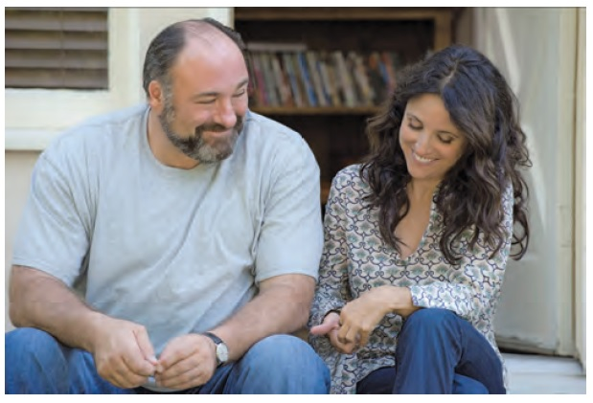
The Perception Process
Interpretation
Factors that affect interpretation (continued):
Expectations
Knowledge
Self-concept
Relational satisfaction

Slide 6
The Perception Process
Negotiation
Influencing one another’s perceptions and trying to achieve a shared perspective
Narratives

Slide 7
Influences on Perception
Access to information
Physiological influences
The senses
Psychological challenges
Age
Health and fatigue
Hunger
Biological cycle

Slide 8
Influences on Perception
Cultural differences
Ethnocentrism
Social roles
Gender roles
Occupational roles
Relational roles

Slide 9
Common Tendencies in Perception
Attribution errors
We judge ourselves more charitably than we judge others
Self-serving bias
We cling to first impressions
Halo effect

Slide 10
Common Tendencies in Perception
Attribution errors (continued)
We assume that others are similar to us
We are influenced by our expectations
We are influenced by the obvious

Slide 11
Perception Checking
Elements of perception checking
A description of the behavior you noticed
At least two possible interpretations of the behavior
A request for clarification about how to interpret the behavior

Slide 12
Perception Checking
Perception-checking considerations
Completeness
Nonverbal congruency
Cultural rules
High context/low context cultures
Face saving

Slide 13
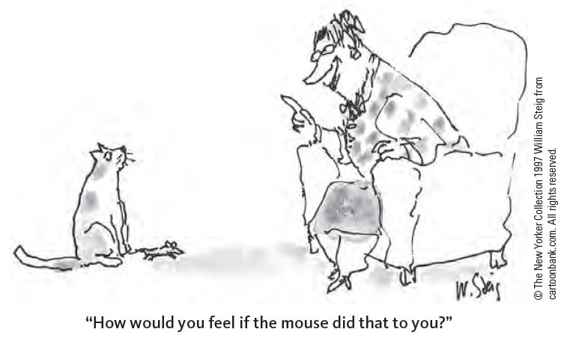
Empathy, Cognitive Complexity, and Communication
Empathy: the ability to re-create another person’s perspective, to experience the world from the other’s point of view
As opposed to sympathy

Slide 14
Empathy, Cognitive Complexity, and Communication
Cognitive complexity and communication
The pillow method:
Position 1: I’m right, you’re wrong
Position 2: You’re right, I’m wrong
Position 3: Both right, both wrong
Position 4: The issue isn’t as important as it seems
Position 5: There is truth in all four perspectives

Slide 15
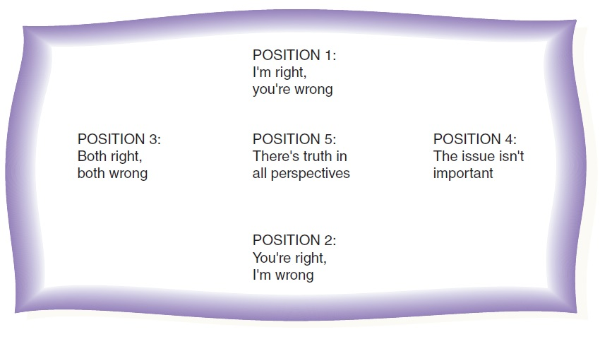
Empathy, Cognitive Complexity, and Communication
The pillow method

