Slide 1
Chapter Five
Looking Out, Looking In
Emotions: Feeling, Thinking, and Communicating

Slide 2
Emotions: Feeling, Thinking, and Communicating
Emotional intelligence: the ability to understand and manage one’s own emotions and be sensitive to others’ feelings
Cengage Learning. Looking Out, Looking In, 15th Edition © 2016. All rights reserved.

Slide 3
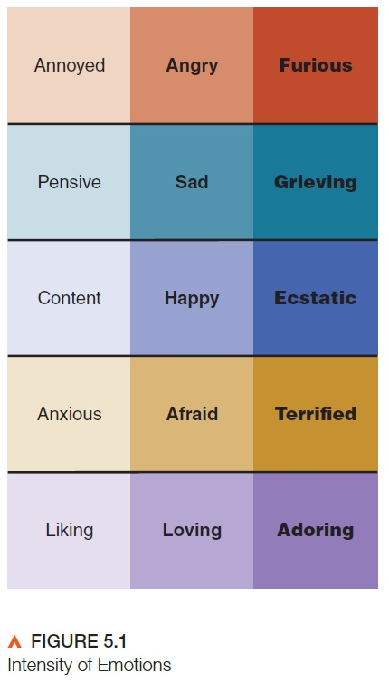
What Are Emotions?
Physiological factors
Nonverbal reactions
Cognitive interpretations
Reappraisal
Verbal expression
Cengage Learning. Looking Out, Looking In, 15th Edition © 2016. All rights reserved.

Slide 4
Influences on Emotional Expression
Influences on emotional expression:
Personality
Culture
Gender
Social conventions
Emotion labor
Social media
Emotional contagion
Cengage Learning. Looking Out, Looking In, 15th Edition © 2016. All rights reserved.
Cengage Learning. Looking Out, Looking In, 15th Edition © 2016. All rights reserved.

Slide 5
Guidelines for Expressing Emotions
Guidelines for expressing emotions:
Recognize your feelings
Recognize the difference between feeling, talking, and acting
Expand your emotional vocabulary
Express feelings by:
Using single words
Describing what’s happening to you
Describing what you’d like to do
Cengage Learning. Looking Out, Looking In, 15th Edition © 2016. All rights reserved.

Slide 6
Guidelines for Expressing Emotions
Guidelines for expressing emotions (continued):
Share multiple feelings
Consider when and where to express your feelings
Accept responsibility for your feelings
Be mindful of the communication channel
Cengage Learning. Looking Out, Looking In, 15th Edition © 2016. All rights reserved.

Slide 7
Managing Emotions
Facilitative emotions versus debilitative emotions
Difference in intensity
Difference in duration
Rumination
Cengage Learning. Looking Out, Looking In, 15th Edition © 2016. All rights reserved.

Slide 8
Managing Emotions
Sources of debilitative emotions
Physiology
Emotional memory
Self-talk
Cengage Learning. Looking Out, Looking In, 15th Edition © 2016. All rights reserved.

Slide 9
Managing Emotions
Irrational thinking and debilitative emotions
The fallacy of perfection
The fallacy of approval
The fallacy of shoulds
The fallacy of overgeneralization
Cengage Learning. Looking Out, Looking In, 15th Edition © 2016. All rights reserved.

Slide 10
Managing Emotions
Irrational thinking and debilitative emotions (continued)
The fallacy of causation
The fallacy of helplessness
The fallacy of catastrophic expectations
Cengage Learning. Looking Out, Looking In, 15th Edition © 2016. All rights reserved.

Slide 11
Managing Emotions
Minimizing debilitative emotions
Monitor your emotional reactions
Note the activating event
Record your self-talk
Reappraise your irrational beliefs
Cengage Learning. Looking Out, Looking In, 15th Edition © 2016. All rights reserved.

Slide 12
Managing Emotions
Maximizing facilitative emotions
Ruminate on the good in life
Enjoy and savor positive emotional experiences
Reappraise challenging situations
Cengage Learning. Looking Out, Looking In, 15th Edition © 2016. All rights reserved.

