Slide 1
Chapter One
Looking Out, Looking In
A First Look at
Interpersonal Communication

Slide 2
Why We Communicate
Physical needs
Identity needs
Social needs
Practical goals
Instrumental goals

Slide 3
The Process of Communication
Linear communication model: communication as something the sender “does to” a receiver
Sender
Encoding
Message
Channel
Receiver
Decoding
Noise

Slide 4
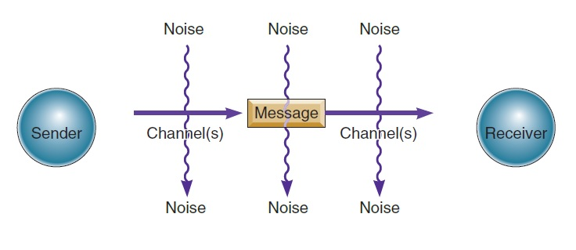
The Process of Communication
Linear communication model

Slide 5
The Process of Communication
Transactional communication model:
Communicators
Environments
Channels
Internal and external noise

Slide 6
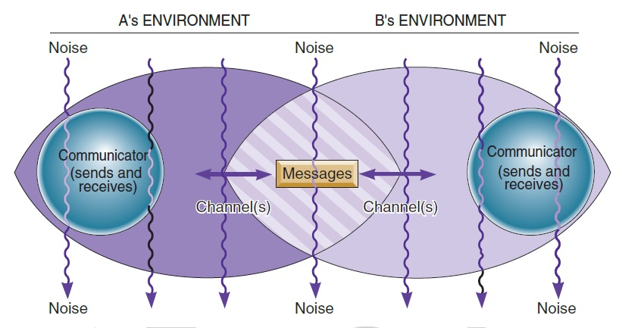
The Process of Communication
Transactional communication model

Slide 7
The Process of Communication
Interpersonal communication
Definition: a transactional process involving participants who occupy different but overlapping environments and create meaning and relationships through the exchange of messages, many of which are affected by external, physiological, and psychological noise
Impersonal communication: the opposite of interpersonal communication

Slide 8
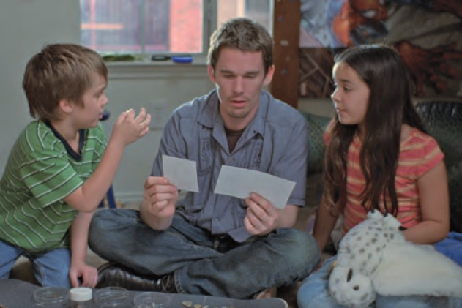
The Process of Communication
Features of interpersonal communication:
Uniqueness (relational culture)
Irreplaceability
Interdependence
Disclosure
Intrinsic rewards

Slide 9
Communication Principles and Misconceptions
Communication principles
Communication can be intentional or unintentional
It’s impossible not to communicate
Communication is unrepeatable

Slide 10
Communication Principles and Misconceptions
Communication principles (continued)
Communication is irreversible
Communication has a content and relational dimension
Content
Information explicitly discussed
Relational
Expresses how you feel

Slide 11
Communication Principles and Misconceptions
Communication misconceptions
More communication is not always better
Meanings are not in the words
Successful communication doesn’t always involve shared understanding
Communication will not solve all problems

Slide 12
What Makes an Effective Communicator?
Communication competence: communicating both effectively and appropriately
There is no ideal way to communicate
A variety of communication styles can be effective
You can always learn new styles of communication
Competence is situational
Competence can be learned

Slide 13
What Makes an Effective Communicator?
Competent communicator characteristics
A wide range of behaviors
Ability to choose the most appropriate behavior
Skill at performing behaviors
Cognitive complexity
Empathy
Self-monitoring
Commitment

Slide 14
What Makes an Effective Communicator?
Competence in intercultural communication
Co-cultures
Know rules of specific culture
Culture-general
Motivation
Tolerance for ambiguity

Slide 15
What Makes an Effective Communicator?
Competence in intercultural communication (continued)
Open-mindedness
Knowledge and skill
Mindfulness
Passive observation
Active strategies
Self-disclosure

