Slide 1
Chapter Three
Looking Out, Looking In
Communication and Identity: Creating and Presenting the Self

Slide 2
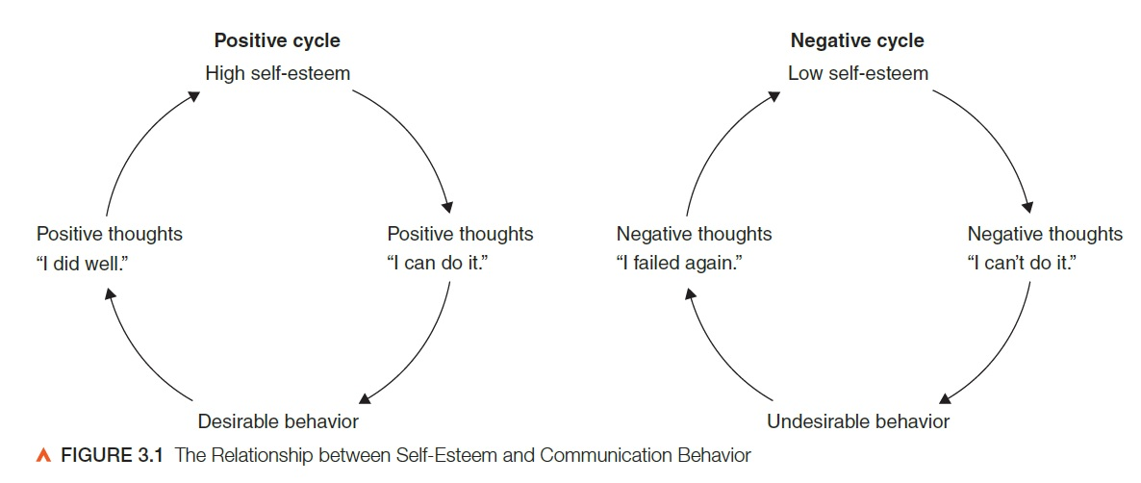
Communication and the Self
Self-concept: the relatively stable set of perceptions you hold of yourself
Self-esteem: evaluations of your self-worth

Slide 3
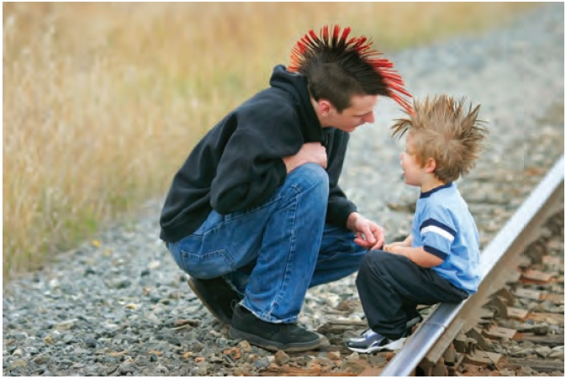
Communication and the Self
Biological and social roots of the self
Biology and the self
Personality
Socialization and self-concept
Reflected appraisal
Social comparison
Reference groups

Slide 4
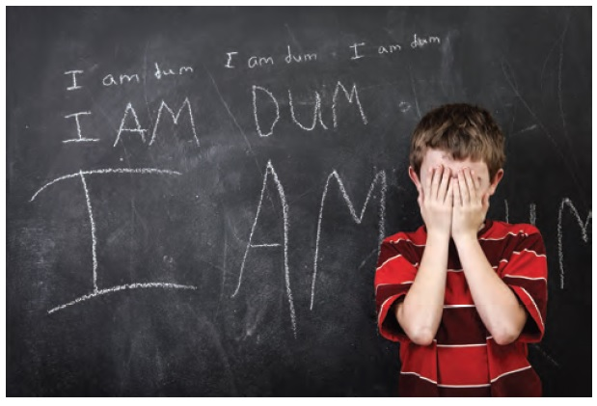
Communication and the Self
Characteristics of the self-concept
The self-concept is subjective
Often distorted positively or negatively due to:
Obsolete information
Distorted feedback
Perfectionism
Social expectations
Internet-mediated reflected appraisal

Slide 5
Communication and the Self
Characteristics of the self-concept
The self-concept resists change
Cognitive conservatism: the tendency to seek and attend to information that conforms to an existing self-concept
Embracing a more positive self-image:
Have realistic perceptions
Have realistic expectations
Have the will to change
Have the skill to change

Slide 6
Communication and the Self
Culture
Individualism/collectivism
Co-cultural identity
Gender
Different messages aimed at males and females
Self-esteem influenced by gender

Slide 7
Communication and the Self
Self-fulfilling prophecy: a person’s expectations of an event, and his or her subsequent behavior based on those expectations, make the event more likely to occur
Self-imposed prophecies
Prophecies imposed by one person on another

Slide 8
Presenting the Self: Communication as Impression Management
Impression management: the communication strategies that people use to influence how others view them
Perceived self
Presenting self (face)

Slide 9
Presenting the Self: Communication as Impression Management
Characteristics of impression management:
We strive to construct multiple identities
Impression management is collaborative
Impression management can be deliberate or unconscious
Why manage impressions?
To start and manage relationships
To gain compliance of others
To save others’ face
To explore new selves

Slide 10
Presenting the Self: Communication as Impression Management
Face-to-face impression management
Manner
Appearance
Setting
Online impression management
Impression management and honesty

Slide 11
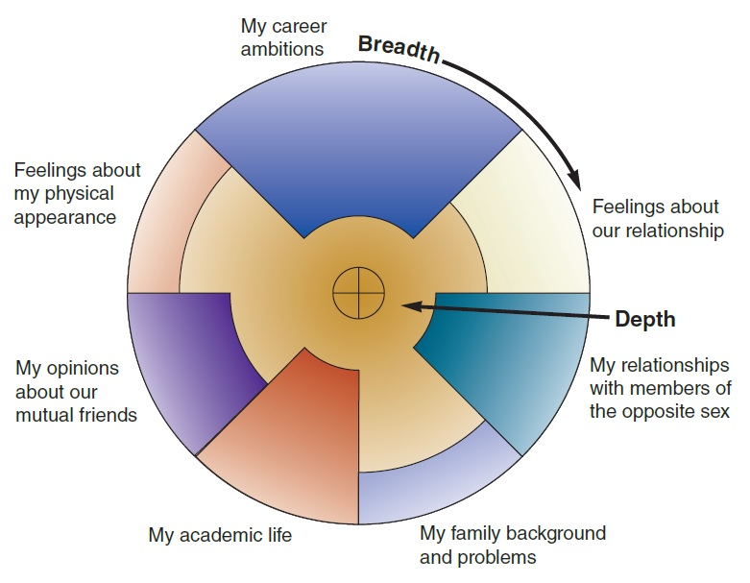
Self-Disclosure in Relationships
Models of self-disclosure
Social penetration model
Breadth
Depth

Slide 12
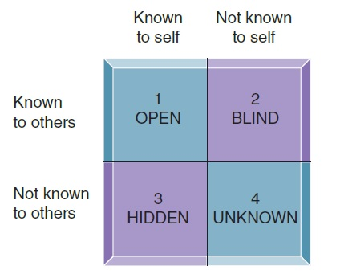
Self-Disclosure in Relationships
Models of self-disclosure
Johari window
Open area
Blind area
Hidden area
Unknown area

Slide 13
Self-Disclosure in Relationships
Benefits of self-disclosure
Catharsis
Reciprocity
Self-clarification
Self-validation
Building and maintaining relationships
Social influence
Risks of self-disclosure
Rejection
Negative impression
Decrease in relational satisfaction
Loss of influence
Hurting the other person

Slide 14
Self-Disclosure in Relationships
Guidelines for self-disclosure
Is the other person important to you?
Are the amount and type of disclosure appropriate?
Is the risk of disclosing reasonable?
Will the effect be constructive?
Is the self-disclosure reciprocated?
Do you have a moral obligation to disclose?

Slide 15
Alternatives to Self-Disclosure
Alternatives to self-disclosure
Silence
Lying
Benevolent lie
Equivocating
Hinting
Ethics of evasion

