Slide 1
Chapter Six
Looking Out, Looking In
Language: Barrier and Bridge

Slide 2
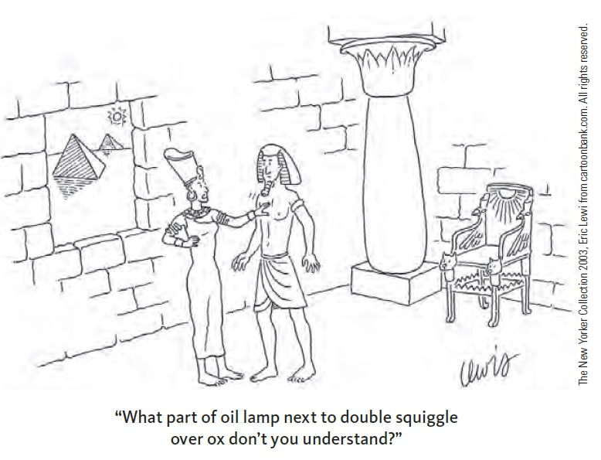
Language Is Symbolic
Language is symbolic
Words and signs are arbitrary
Symbolic language
Allows for more communication
Can lead to communication breakdowns

Slide 3
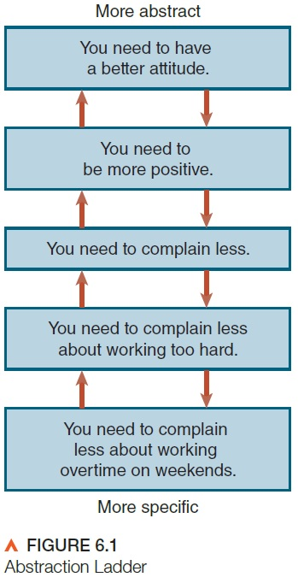
Understandings and Misunderstandings
Understanding words: semantic rules
Equivocation
Relative words
Static evaluation
Abstraction
Abstract language
Behavioral language

Slide 4
Understandings and Misunderstandings
Understanding structure: syntactic rules
Syntactic rules govern grammar
Co-cultures may use different (not deficient) syntactic rules

Slide 5
Understandings and Misunderstandings
Understanding context: pragmatic rules
Pragmatic rules are used to decide how to interpret messages in context
Shared by a culture
Shared by individuals in relationships

Slide 6
The Impact of Language
The impact of language
Naming and identity
Affiliation
Convergence
Divergence
Power and politeness

Slide 7
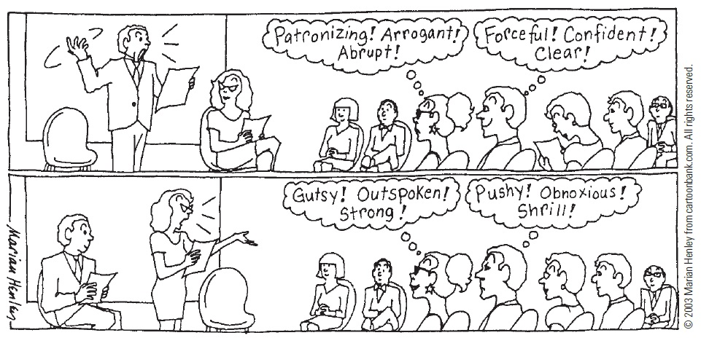
The Impact of Language
Disruptive language
Fact-opinion confusion
Fact-inference confusion
Emotive language

Slide 8
The Impact of Language
The language of responsibility
“It” statements
“But” statements
“I” and “you” language
“We” language

Slide 9
Gender and Language
Gender affects language:
Content
Reasons for communicating
Conversational style

Slide 10
Gender and Language
Nongender variables:
Social philosophy
Speaker orientation (competitive or cooperative)
Occupation
Gender role

Slide 11
Culture and Language
Verbal communication styles
Direct and indirect
Low-context and high-context cultures
Elaborate and succinct
Formal and informal

Slide 12
Culture and Language
Language and worldview
Linguistic relativity: the worldview of a culture is shaped and reflected by the language its members speak
Sapir-Whorf hypothesis

