Slide 1
Chapter Seven
Looking Out, Looking In
Nonverbal Communication: Messages Beyond Words

Slide 2
Characteristics of Nonverbal Communication
Nonverbal skills are vital
All behavior has communicative value
Nonverbal communication is primarily relational
  Impression management
  Reflecting and shaping relationships
  Conveying emotions
Cengage Learning. Looking Out, Looking In, 15th Edition © 2016. All rights reserved.

Slide 3
Characteristics of Nonverbal Communication
Nonverbal communication occurs in mediated messages
  Emoticons and emoji
  Punctuation and lexical surrogates
  Time management
Cengage Learning. Looking Out, Looking In, 15th Edition © 2016. All rights reserved.

Slide 4
Characteristics of Nonverbal Communication
Nonverbal communication serves many functions
  Repeating
  Complementing
  Substituting
  Accenting
  Regulating
  Contradicting
    Mixed messages
Cengage Learning. Looking Out, Looking In, 15th Edition © 2016. All rights reserved.

Slide 5

Characteristics of Nonverbal Communication
Nonverbal communication offers deception cues
Nonverbal communication is ambiguous
Cengage Learning. Looking Out, Looking In, 15th Edition © 2016. All rights reserved.

Slide 6
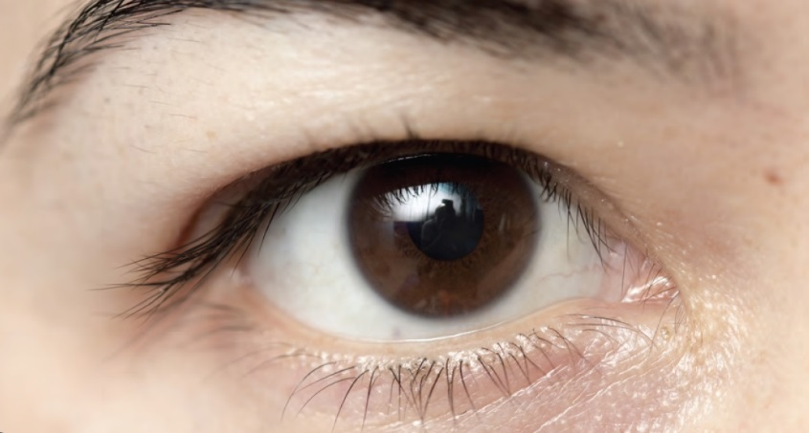
Influences on Nonverbal Communication
Gender
Culture
  Personal space
  Eye contact
  Use of time
    Monochronic cultures
    Polychronic cultres
  There are some universal nonverbal behaviors
Cengage Learning. Looking Out, Looking In, 15th Edition © 2016. All rights reserved.

Slide 7
Types of Nonverbal Communication
Body movement (kinesics)
  Body orientation
  Posture
  Gestures
    Illustrators
    Emblems
    Adaptors
    Manipulators
    Face and eyes
      Microexpressions
Cengage Learning. Looking Out, Looking In, 15th Edition © 2016. All rights reserved.

Slide 8
Types of Nonverbal Communication
Voice (paralanguage)
  Emphasis
  Tone
  Rate
  Pitch
  Volume
  Pauses
    Unintentional pauses
    Vocalized pauses
Cengage Learning. Looking Out, Looking In, 15th Edition © 2016. All rights reserved.

Slide 9

Types of Nonverbal Communication
Touch (haptics)
Appearance
  Physical attractiveness
  Clothing
Cengage Learning. Looking Out, Looking In, 15th Edition © 2016. All rights reserved.

Slide 10

Types of Nonverbal Communication
Physical space (proxemics)
  Distance
    Intimate distance
    Personal distance
    Social distance
    Public distance
  Territoriality
Cengage Learning. Looking Out, Looking In, 15th Edition © 2016. All rights reserved.

Slide 11
Types of Nonverbal Communication
Physical environment
Time (chronemics)
  Indicates power and status
  Reflects the state of a relationship
Cengage Learning. Looking Out, Looking In, 15th Edition © 2016. All rights reserved.

